Slide 1
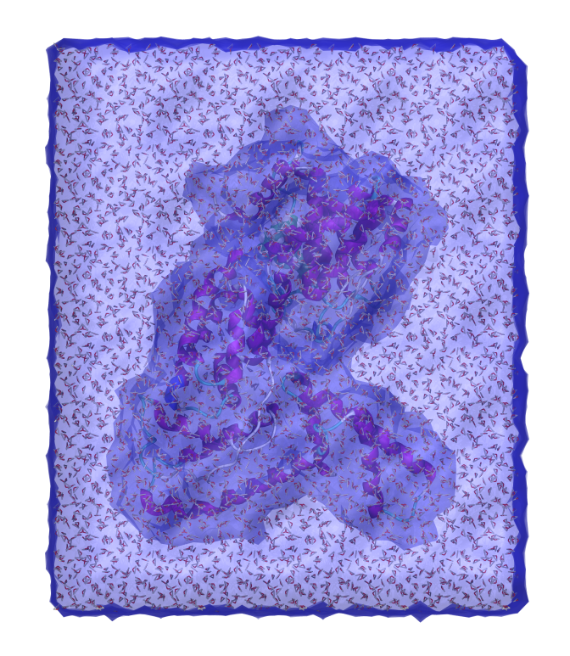
Molecular Graphics and Computation Facility
https://mgcf.cchem.berkeley.edu
Dr. Azhagiya Singam
Dr. Dave Small
Dr. Kathy Durkin
mgcf@berkeley.edu
175 Tan Hall
Vitamin D Binding protein in water box
PDB code: 1J78
Rendered in VDM
Notes:
09/27/12
1
09/27/12
1
1

Slide 2
Chem260/295 – MGCF Computation Project
https://mgcf.cchem.berkeley.edu/chem260+295
September (Chem 200):
Sign up for in person training (today!) Link will be sent to your bmail
3 hour session
Sessions available: M, W, F 9am-noon, 1-4pm, Tu, Th 1-4pm. Sept 9-13
Groups of about 10 people
Notes:
09/27/12
2
09/27/12
2

Slide 3
Chem260/295 – MGCF Computation Project
https://mgcf.cchem.berkeley.edu/chem260+295
September (Chem 200):
Sign up for in person training (today!).
Do our prelab.
Come for in person training (north side 175 Tan Hall.
Try remote login to MGCF.
Zoom office hours for help and/or email us for individual meetings.
Notes:
09/27/12
3
09/27/12
3

Slide 4
Tutorials
Linux bootcamp: (5-10 minutes)
Modeling of organic molecule: minimization, coordinate scan, conformational search, Boltzmann distribution, experimental data (30-40 minutes - molecular mechanics)
DFT on inorganic complex: optimization, visualize MO’s, IR spectra; calculate free energy of reaction (15-30 minutes – using quantum mechanics)
Optional tutorials based on your interest (30-90 minutes):
DFT search for SN2 transition state
Ligand docking to protein, Molecular Dynamics
Materials Science - Periodic Cell, MOF, Powder Diffraction
Notes:
09/27/12
4
09/27/12
4

Slide 5
Chem260/295 – MGCF Computation Project
https://mgcf.cchem.berkeley.edu/chem260+295
Week 6: Proposal (1-2p). About your research! Earlier is fine if you are already in a group. Due (approx) 10/18.
We will invite you to individual meetings to discuss.
Weeks 7-14: Work on your project!
Week 14: Report (3-5 pages). Due (12/6) last day of classes
Notes:
09/27/12
5
09/27/12
5

Slide 6
Chem260/295 – MGCF Computation Project
https://mgcf.cchem.berkeley.edu/chem260+295
September (Chem 200):
Sign up for in person training (today!). Link will be sent to your bmail.
3 hour session
Sessions available: M, W, F 9am-noon, 1-4pm, Tu, Th 1-4pm. Sept 9-13.
Groups of about 10 people
Notes:
09/27/12
6
09/27/12
6

